Slide 1

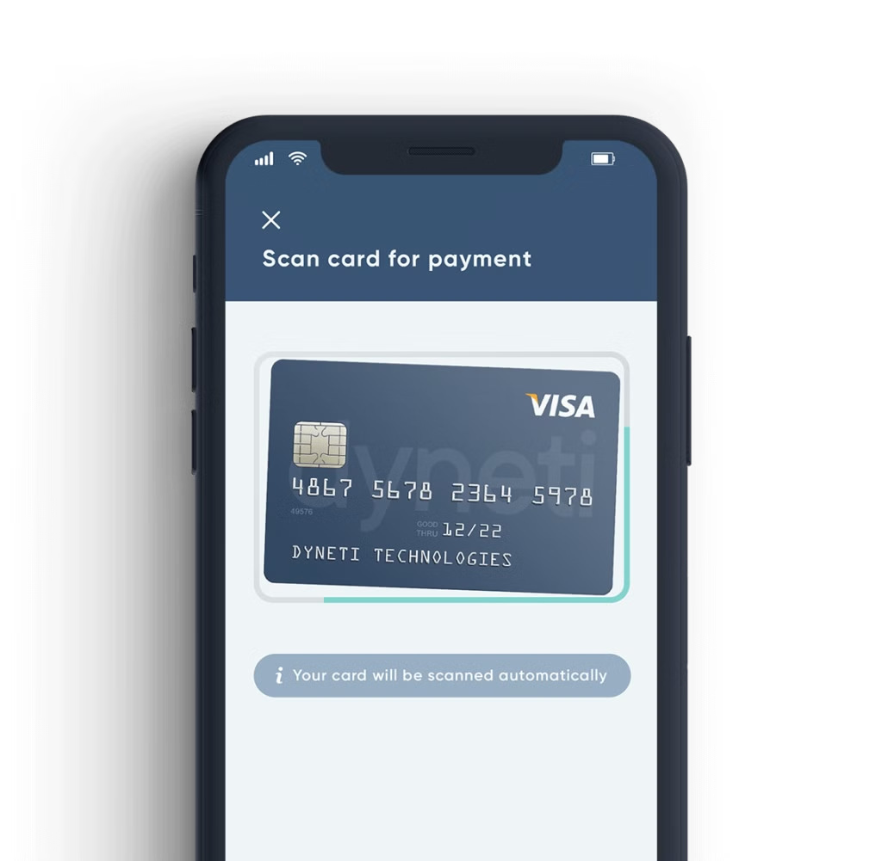
Credit Card Fraud
Detection: A Comprehensive Guide
Credit card fraud is a serious problem that affects millions of people worldwide. This presentation will explore the different aspects of credit card fraud detection, including the types of fraud, the data used, and the machine learning techniques employed to prevent it.

Slide 2

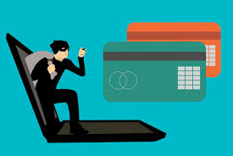



Understanding the Importance of Fraud Prevention
1
Financial Loss
Fraudulent transactions can result in significant financial losses for both individuals and businesses. It can also lead to compromised credit scores and difficulty accessing financial products.
2
Damage to Reputation
Businesses with a high rate of fraud can suffer reputational damage, leading to loss of customer trust and revenue.
3
Legal Consequences
Failing to implement robust fraud detection measures can lead to legal repercussions and fines.

Slide 3
Common Types of Credit Card Fraud
Card Not Present Fraud
Making unauthorized transactions using stolen credit card information without physically presenting the card.
Identity Theft
Stealing personal information to open new credit cards or make fraudulent transactions.
Skimming
Using a device to steal credit card information from a card reader.

Slide 4

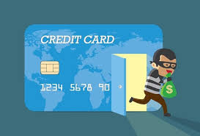



Data Sources for Fraud Detection
Transaction Data
Information about purchase history, amount, location, and merchant details.
Customer Data
Demographic information, credit history, and account activity patterns.
Network Data
Information about the device used for the transaction, IP address, and geolocation data.

Slide 5






Machine Learning Techniques in Fraud Detection
Supervised Learning
Training models on labeled data to identify fraudulent transactions.
1
Unsupervised Learning
Identifying patterns in data to detect anomalies and potential fraud.
2
Reinforcement Learning
Optimizing fraud detection models based on real-time feedback.
3

Slide 6
Feature Engineering for Fraud Modeling
Time-based Features
Transaction frequency, time of day, and day of the week.
Location-based Features
Geolocation, distance from previous transactions, and merchant location.
Behavioral Features
Spending patterns, transaction history, and account activity.

Slide 7




Evaluating Fraud Detection Models
Accuracy
The model's ability to correctly identify both fraudulent and legitimate transactions.
Precision
The percentage of predicted fraudulent transactions that are actually fraudulent.
Recall
The percentage of actual fraudulent transactions that are correctly identified by the model.
F1 Score
A harmonic mean of precision and recall, providing a balanced measure of model performance.

Slide 8

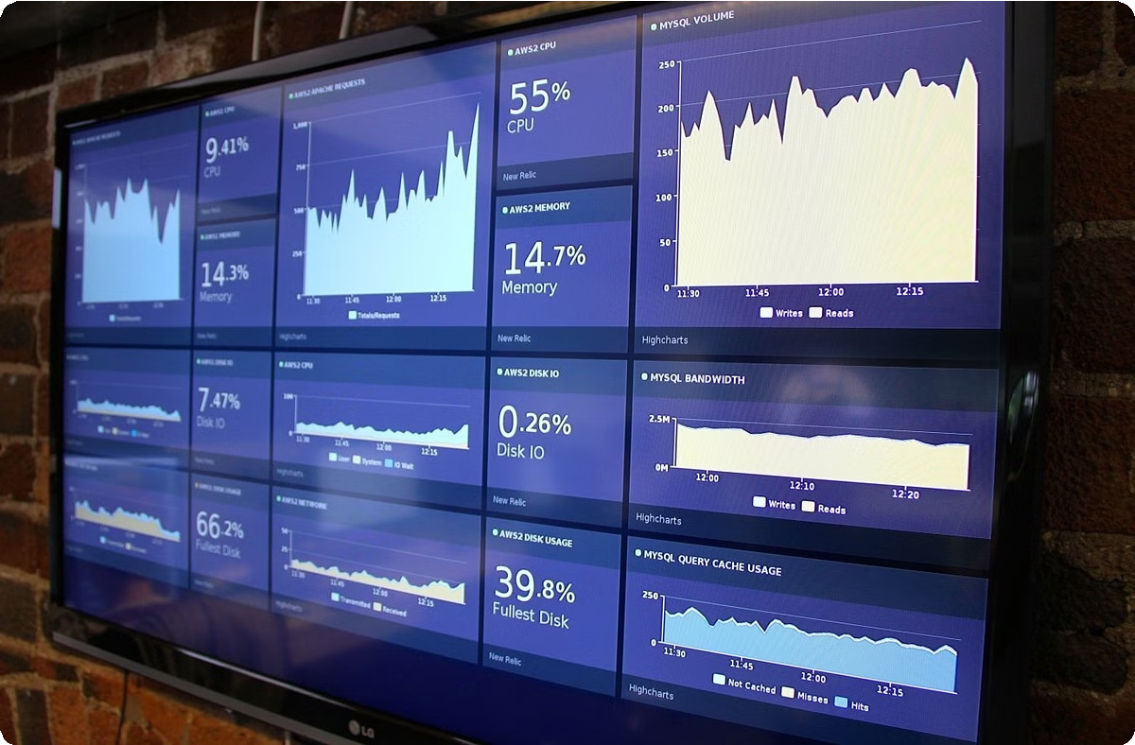



Implementing Fraud Detection in Real-Time
1
Data Ingestion
Collecting and processing transaction data in real-time.
2
Model Prediction
Applying the fraud detection model to incoming transactions to generate predictions.
3
Alerting and Response
Triggering alerts for suspicious transactions and taking appropriate actions to prevent fraud.

Slide 9




Challenges and Limitations in Fraud Detection
1
Evolving Fraud Tactics
Fraudsters are constantly developing new methods to bypass detection systems.
2
Data Quality Issues
Inaccurate or incomplete data can hinder the effectiveness of fraud detection models.
3
Balancing Security and User Experience
Striking a balance between preventing fraud and avoiding unnecessary friction for legitimate users.

Slide 10


Conclusion and Future Considerations
Credit card fraud detection is an ongoing battle. As technology advances, new challenges will emerge. The future of fraud detection lies in leveraging advanced machine learning techniques, real-time data processing, and collaborative efforts to combat fraud effectively.

Slide 11
Thank you

